Slide 1
Diversifying through a Risk-Parity approach

Slide 2
Focus
Portfolio diversification is thought of in terms of weight distribution across asset classes
Traditional portfolio construction methods include 60/40 and equal weights across asset classes
Potential problem: assets behave differently across economic environments
A different approach towards portfolio construction might be to consider equal-risk contribution
A Risk-Parity Portfolio can offer “True” diversification and stronger long-term performance
Risk budget of the portfolio is not concentrated in equities, but spread more evenly across the portfolio
Higher Sharpe Ratio
Replicating Risk-Parity Portfolio, consisting of 3 asset classes: equity, bonds, commodities, with modification to equity structure:
Including two-factor model (Value and Momentum) in the equity portfolio
Using VTV (Value) and MTUM (Momentum) proxy indices
Goal: compare the unlevered/levered Risk-Parity portfolio with the “traditional” equal-weight portfolio
Notes:
Zehua

Slide 3
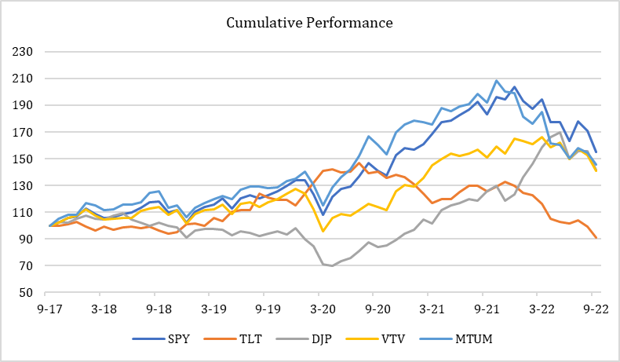
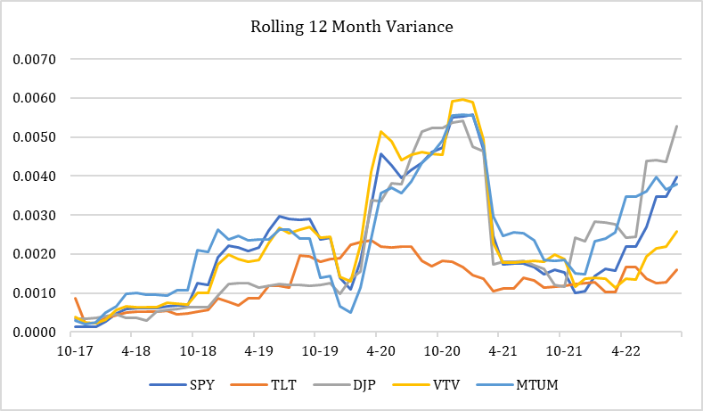
Background
At September 30, 2022. Source: Yahoo Finance.
Notes:
Zehua

Slide 4
Methodology
Coding Language: Python -> for data mining and analysis
Yahoo Finance for adjusted closing price data (via pandas-datareader Python library)
Used Sep 2016 - Sep 2022 for backtesting
ETFs for asset class proxies: Equities: SPY, Bonds: TLT, Commodities: DJP
2-factor equity selection: Momentum factor and value factor proxies (50/50):
MTUM ETF (iShares MSCI USA Momentum Factor ETF)
VTV ETF (Vanguard Value Index Fund ETF)
Used Scipy.optimize: minimize for the weight optimization
Constraints:
Non-negative weights sum up to 1
Marginal risk contribution across assets are all equal
Monthly weight rebalancing (Beginning of the month)
Leveraging applied monthly to have same risk across all 3 portfolios
Notes:
Matthew

Slide 5
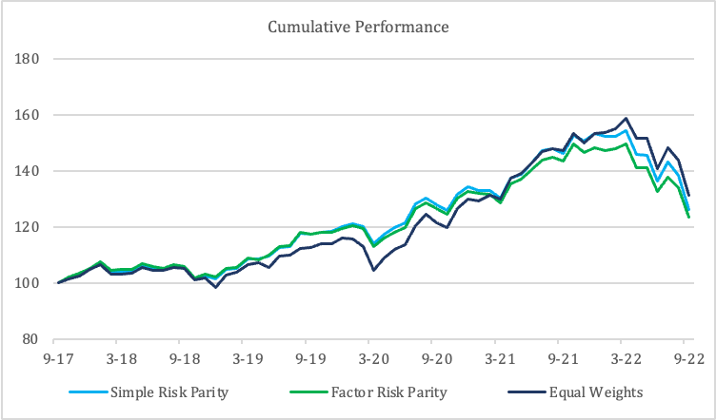
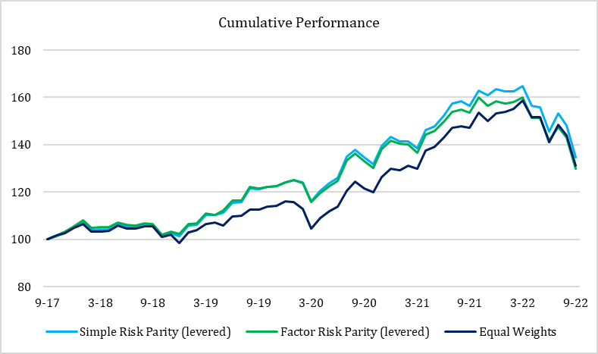
Results
Unlevered
Levered
At September 30, 2022. Source: Yahoo Finance.
Notes:
Matthew

Slide 6
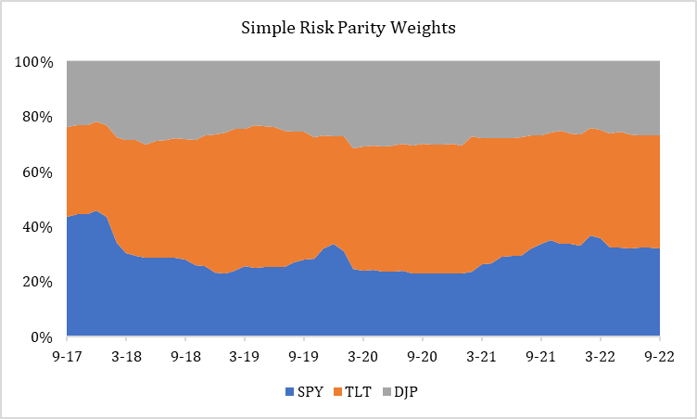
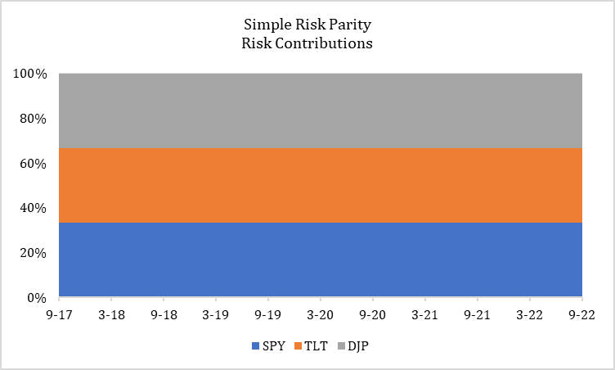
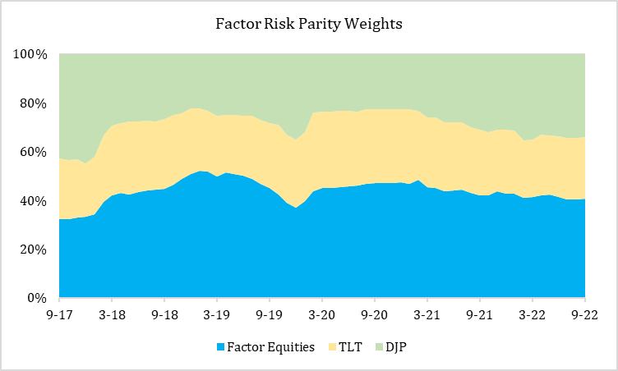
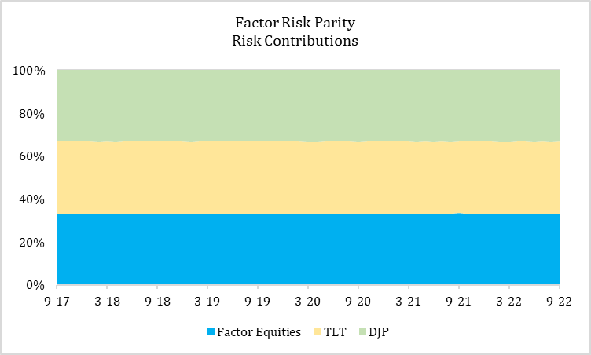
Simple vs. factor risk parity
At September 30, 2022. Source: Yahoo Finance.
Notes:
Chen
First of all, I want you guys pay attention to the right hand side which has two charts. They depict a scenario of equal marginal risk contributions of equities, bonds, and commodities for the simple risk parity and factor risk parity portfolios. We achieve it by consistently rebalancing or rather, optimizing the weights of the assets across the portfolios on a monthly basis. In particular, regarding the factor risk parity combination, instead of simply using equities, we select a 2--factor strategy which involves equally weighted momentum and value factor proxies of ETFs.
And, in terms of the left hand side containing two charts, they correspond to the weights of the assets that result in identical risk contributions. A specific issue that we should note is that the width of the bands is inversely proportional to the risk level, i,e, the wider the band, the more risky the kind of asset is. So, during the pre-covid period, which is roughly before march 20, 2020, in the simple risk parity portfolio the bonds vlt has the widest band, as is aligned with the fact that bonds typically are the least risks. However, after the march 20, 2020, commodities djp suddenly take up a greater weight, indicating that commodities become sort of less risky than bonds within unusual economic environments. Meanwhile, in the factor risk parity portfolio, we can find that the 2-factor equities have a lower volatility or risk level when covid is not there. With the advent of covid, the impact caused these equities more risky as expected, according to the wider band section here. But, the combination of value and momentum factors is more resistant to economic downside, as the width of the band recovers shortly after the contraction. It potentially suggests that we may better hedge risks by using a value-momentum portfolio relative to the ordinary stocks. And we might even further reinforce the capacity by adjusting the weights of value and momentum factors.

Slide 7
Performance Summary
Sep 2017 - Sep 2022 | Simple Risk Parity (Levered) | Factor Risk Parity (Levered) | Equal Weights
Ann Mean | 6.5% | 5.8% | 6.0%
Cumulative Return | 34.7% | 30.0% | 31.3%
Ann Return | 6.1% | 5.4% | 5.6%
Ann Std Dev | 10.5% | 10.4% | 10.5%
Ann Sharpe Ratio | 0.58 | 0.52 | 0.53
Tracking Error | 2.8% | 3.1% | 0.0%
Maximum Drawdown | -18.4% | -18.8% | -17.4%
At September 30, 2022. Source: Yahoo Finance.
Notes:
Chen
Then, you may have a check of the summary of our analysis, including annual mean returns, cumulative returns, etc. here, we prefer to set up benchmarks of the overall performance of the three portfolios by choosing annual returns, std dev, and sharpe ratio. Initially, simple risk parity and factor risk parity both had a lower std dev and return levels than the equally weighted portfolio. After leverage these two portfolios, we managed to increase their risk levels to equal that of the portfolio with equal weights. Also, we make the ann returns higher. In our viewpoint, the simple risk parity portfolio is the optimal one among the three, when it has the highest ann returns and ann sharpe ratio.

Slide 8
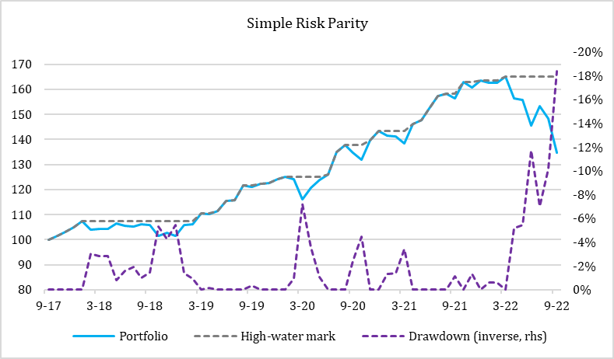
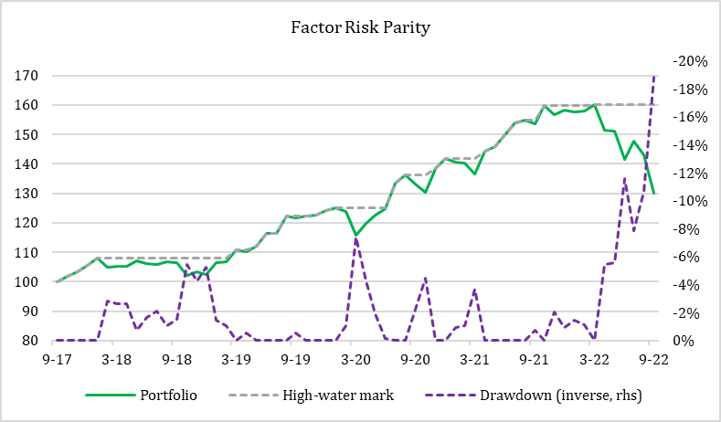
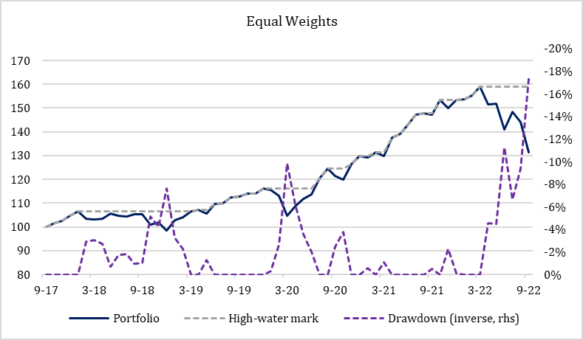
Results (cont.)
At September 30, 2022. Source: Yahoo Finance.
Notes:
Artiom

Slide 9
Further Discussion
Limitations:
Not accounting for transaction costs
We are looking at adjusted closing prices
We aren’t accounting for the market impact of rebalancing each month
We aren’t accounting for volume
Improvements:
Create own value/momentum 2-factor model for all asset classes
Accounting for transaction costs and market impacts
Constructing a long/short portfolio, instead of long only.
Notes:
Artiom

Slide 10
Thank You

